Slide 1
Research Techniques and tools: Sampling Techniques
Dr Vinit Kumar

Slide 2
Research Process
Generalize
Interpret to draw conclusions
Collect & Analyze Data
Operationalize
Narrow down to specifics
Start with Broad Questions

Slide 3
Research techniques
Ways of collecting data.
Often we do not have to generate data ourselves: it is waiting to be collected.
Documents/literature
Questionnaire and Schedule
Observation
Interview

Slide 4
Sampling
Sampling is the process of selecting a small number of elements from a larger defined target group of elements such that the information gathered from the small group will allow judgments to be made about the larger groups.

Slide 5
Basics of Sampling Theory
Population
Element
Defined target
population
Sampling unit
Sampling frame

Slide 6
Sampling Techniques
Population : All members of a group about which one wants to draw conclusion. Or The complete set of data elements under consideration.
Studies based on population is called Census.
+ No element of chance is left
+ high accuracy of data
- slightest bias will increase as the number of observations are more
- great deal of time, money and energy is required
The characteristics of population is known as parameters.

Slide 7
Sampling Techniques
Sample : A portion of a population selected for further analysis. Or A portion or part of data elements under consideration.
+ bias can be eliminated
+ lesser time, money and energy is required
- accuracy of data is at doubt

Slide 8
Developing a Sampling Plan(sample design)
Define the Population of Interest(Universe)
Identify a Sampling Frame (if possible)
Select a Sampling Method
Determine Sample Size
Execute the Sampling Plan

Slide 9
Define the Population of Interest(Universe)
Clearly define the population to be studied.
There can be two types of population
Finite universe : No of items are certain. Ex. No of employees in an Org.
Infinite universe : No of items are uncertain. Ex. Stars in the sky
This step also involves deciding the major entity on which your study will be based also known as sampling units.
It can be:
Social units : Librarians, Children, chemists, teachers, etc.
Geographical units : urban, Rural, City, State, etc.
Social phenomenon : Arrests, Accidents, etc.
Artefacts : Publications, patents, paintings, etc.
A combination of above.

Slide 10
Identify a Sampling Frame (if possible)
Also known as preparing the source lists.
It contains the names of all the items of a population.
The list should be complete, correct and reliable.
Sample frame error occurs when certain elements of the population are accidentally omitted or not included on the list.

Slide 11
Select a Sampling Method
Decide upon the types of sampling method or technique for taking out the items for the sample.
Here it becomes important to understand the characteristics of a good sample.
Must result in a truly representative sample.
Must result in a small sampling error.
Must be viable in the contexts of funds available.
Sample should be such that the results of the sample study can be applied, in general, for the universe with a reasonable level of confidence.

Slide 12
Sampling Methods
Probability
sampling
Nonprobability
sampling

Slide 13
Probability Sampling
Drawing samples form the population according to some laws of chance.
Law of Statistical Regularity : if an average sample chosen in random one, the sample will have the same composition and characteristics as the universe.
Each unit in the population has some definite pre-assigned probability of being selected in the sample.
Simple Random
Sampling
Restricted Random
Sampling

Slide 14
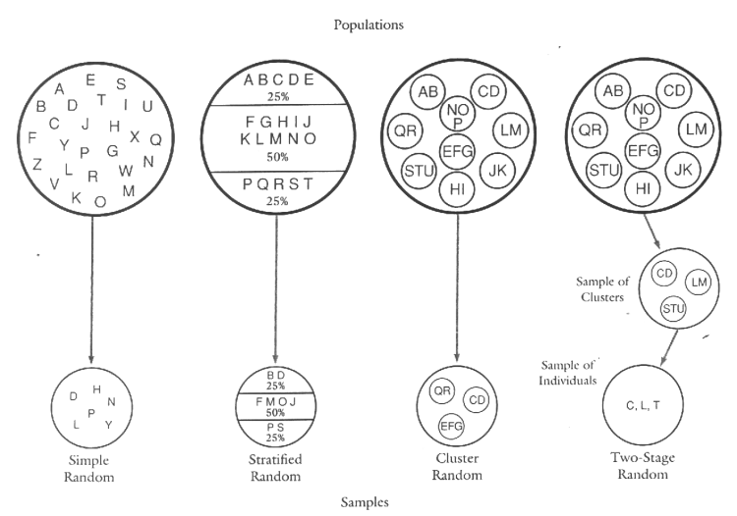
Simple Random Sampling
Method of selection of a sample in such a way that each and every member of population or universe has equal chance or probability of being included in the sample.
One member does not affect the chance of others.
Possible only for the populations whose all the members are known.
Methods
Lottery method : slips in a drum. Picking names from the list blind folded.
Random Number Method : On the basis of random numbers available from random number tables or Random Number Generators.

Slide 15
Random number tables/generators
Tippets Random number series --- from census data
Fisher’s and Yates number series --- from log tables
Kendall and Belington number series --- set of 60000 digits
Rand Corporations number series --- produces random digits
Excel rand() function

Slide 16
Restricted Random Sampling
Each unit in the population has known probability of selection in the sample.
Systematic Sampling
Stratified Sampling
Cluster Sampling
Multistage Sampling

Slide 17
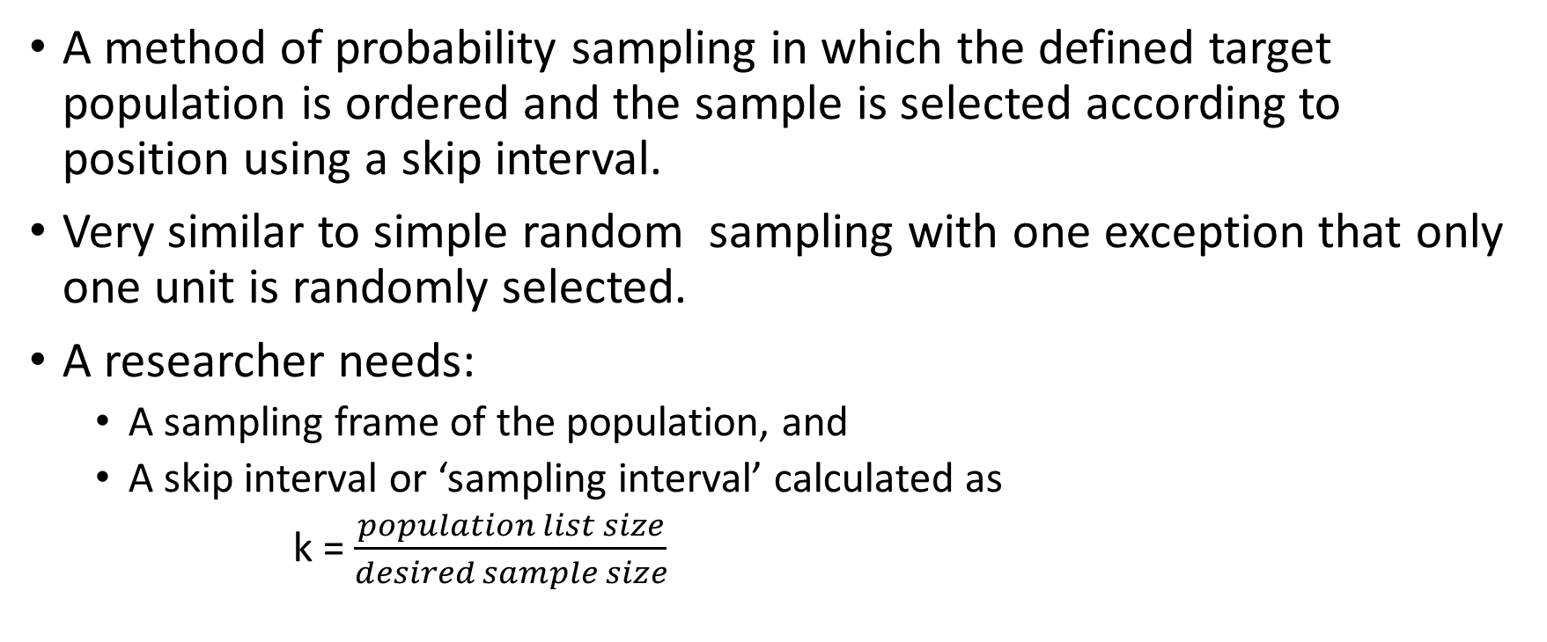
Systematic Sampling
A method of probability sampling in which the defined target population is ordered and the sample is selected according to position using a skip interval.
Very similar to simple random sampling with one exception that only one unit is randomly selected.
A researcher needs:
A sampling frame of the population, and
A skip interval or ‘sampling interval’ calculated as
k = $\frac{population list size}{desired sample size}$

Slide 18
Steps
Randomly select a number between 1 and k include in the sample.
Include each k^{th} element in the sample.
For example: if k is 10 and randomly selected number between 1 and 10 is 5, then elements 5, 15, 25,35,45 will be selected.

Slide 19
Stratified Sampling
Stratified random sampling is a method of probability sampling in which the population is divided into different subgroups and samples are selected from each subgroup.
Divide the target population into homogeneous, mutually exclusive, and collectively exhaustive subgroups or strata using a stratification variable
Draw simple random samples from each stratum
Combine the samples from each stratum into a single sample of the target population

Slide 20
Types of stratified sampling
Proportional stratified sampling: The sample are proportional to their sizes in the population.
Disproportional stratified sampling: The subsamples are not proportional to their sizes in the population.
Say, The population has 75% female and 25% male. If you want a sample size of 100 and your variable is gender.
For PSS: We will randomly select 75 females and 25 % males.
For DSS: We might randomly select 50 females and 50 males from each stratum.

Slide 21
Cluster Sampling
A type of sampling in which clusters or groups of elements are sampled at the same time.
The clusters are randomly selected rather than individual units.
Steps:
Defined population is divided into number of heterogeneous, mutually exclusive and collectively exhaustive sub groups or clusters.
Select an independent simple random sample of clusters.
One special type of cluster sampling is called area sampling, where pieces of geographical areas are selected.

Slide 22
Cluster Sampling
One stage cluster sampling:
Subdivide the members into clusters cluster
Select one of the clusters
All the members of the selected cluster are sample.
Two stage cluster sampling
At the first stage, the clusters are randomly selected and then,
At the second stage, random sample of the elements in each of the cluster is taken.

Slide 23
Stratified Sampling vs Cluster Sampling
Stratified Sampling | Cluster Sampling
The target population is sub-divided into a few subgroups or strata, each containing a large number of elements. | The target population is sub-divided into a large number of sub-population or clusters, each containing a few elements.
Within each stratum, the elements are homogeneous. However, high degree of heterogeneity exists between strata. | Within each cluster, the elements are heterogeneous. Between clusters, there is a high degree of homogeneity.
A sample element is selected each time. | A cluster is selected each time.
Less sampling error. | More prone to sampling error.
Objective is to increase precision. | Objective is to increase sampling efficiency by decreasing cost.

Slide 24
Nonprobability
sampling
Each element in the population does not have known or definite probability of being selected in the sample.
Operationally convenient and simple in theory.
Generalisation is doubtful.
Helpful in the case of infinite population.

Slide 25
Non-Probability Sampling
Convenience sampling
Drawn at the convenience of the researcher, access and availability. Common in exploratory research(Pilot tests). Very simple types of sampling based on subjective criteria.
Judgmental/purposive sampling
Sampling based on some judgment, gut-feelings or experience of the researcher.
Research sets some purpose or characteristics on the basis of his/her personal judgement.
If inference drawing is not necessary, these samples are quite useful.
Ex. If you decide, you want to include research scholars getting scholarships and you chose 50 scholars who meet this criteria.
Based on subjective criteria.

Slide 26
Non-Probability Sampling
Quota sampling
An extension of judgmental sampling.
A population is divided into subgroups, similar to stratified sampling, but the researcher gathers individuals for the sample using convenience or judgmental manner.
It is something like a two-stage judgmental sampling.
Quota is fixed for each subgroup.
Snowball sampling
Used in studies involving respondents who are rare to find.
To start with, the researcher compiles a short list of sample units from various sources.
Each of these respondents are contacted to provide referrals/names of other probable respondents.
Another type of convenience sampling method used in situations in which desired respondents are difficult to locate due to scarcity or rarity.

Slide 27
Choosing probability vs. non-probability sampling
Probability Evaluation Criteria Non-probability
sampling sampling
Conclusive Nature of research Exploratory
Less bias Relative magnitude Larger chances of bias
sampling vs. non-sampling error
High Population variability Low
[Heterogeneous] [Homogeneous]
Favourable Statistical Considerations Unfavourable
High Sophistication Needed Low
Relatively Longer Time Relatively shorter
High Budget Needed Low

Slide 28
Sampling vs non-sampling errors
Sampling Error [SE] Non-sampling Error [NSE]
Very small sample Size
Larger sample size
still larger sample
Complete census

Slide 29
Developing a Sampling Plan(sample design)
Define the Population of Interest(Universe)
Identify a Sampling Frame (if possible)
Select a Sampling Method
Determine Sample Size
Execute the Sampling Plan

Slide 30
Determine the Sample Size
Difficult step.
Sample size depends on many factors:
the purpose of the study
the size of the population, and
the research techniques used.

Slide 31
Sample size may be determined by using:
Subjective methods (less sophisticated methods)
The rule of thumb approach or criterion based: eg. 5% of population or N=100 take 15-30%, N=1000 10-15%
Conventional approach: e.g. Average of sample sizes of similar other studies;
Cost basis approach: The number that can be studied with the available funds;
Statistical formulae (more sophisticated methods)
Confidence interval approach.
Degree of precision desired in estimating the population characteristic
Amount of variability of the population characteristic under investigation in the population (homogeneity);
Level of confidence required in the estimates of population values.
Tables and calculators
Rule of thumb is the bigger the sample, the better it will usually represent the population.

Slide 32
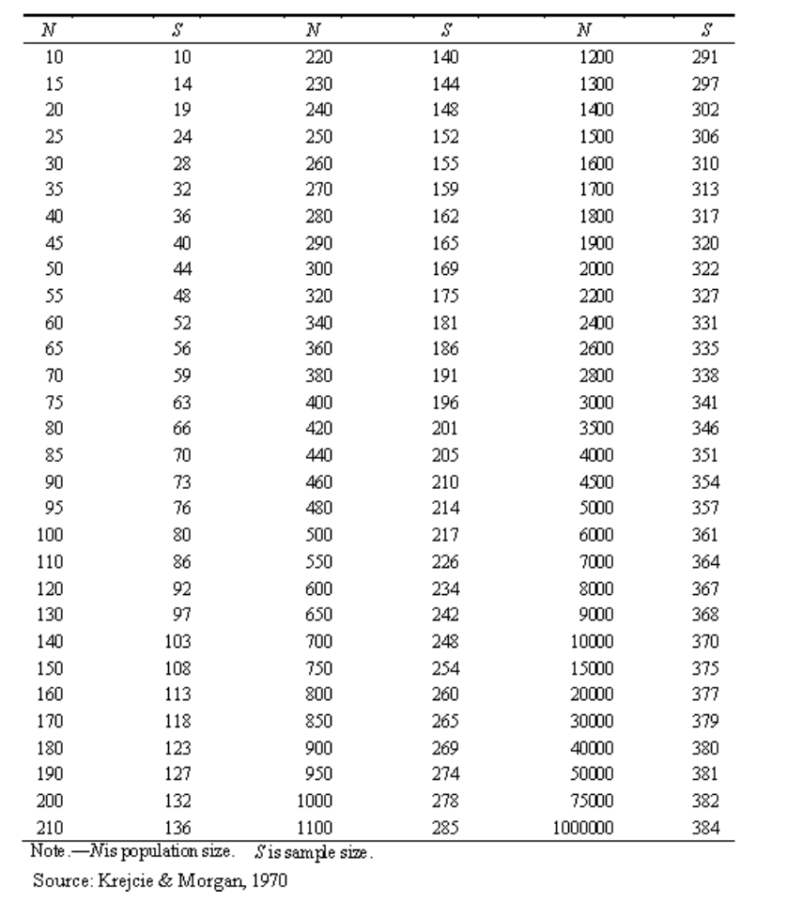
Sample size tables
Krejcie and Morgan (1970)
95% level of confidence

Slide 33
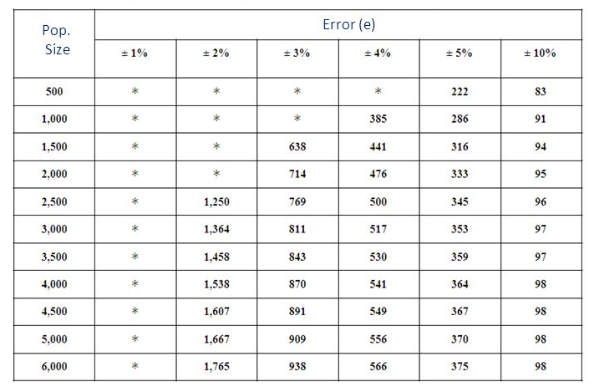
Taro Yamane
Assuming population proportion of 0.5 and confidence 95%

Slide 34
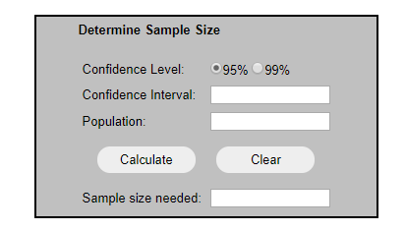
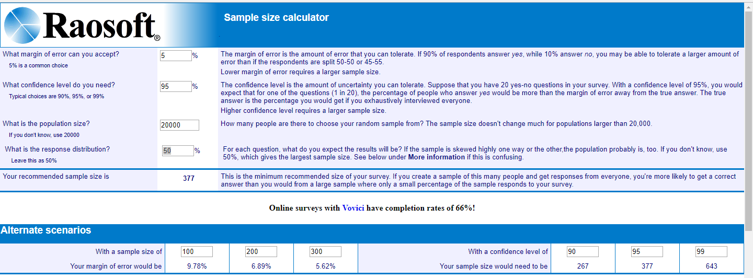
For a simple sample size calculator, click here:
http://www.surveysystem.com/sscalc.htm
http://www.raosoft.com/samplesize.html

Slide 35
Execute the Sampling Plan

Slide 36
Factors to Consider in Sample Design
Research objectives
Degree of accuracy
Resources
Time frame
Knowledge of
target population
Research scope
Statistical analysis needs

